Slide 1
Creating Wordle with Python
By Ethan Rheams and Brady Katler

Slide 2
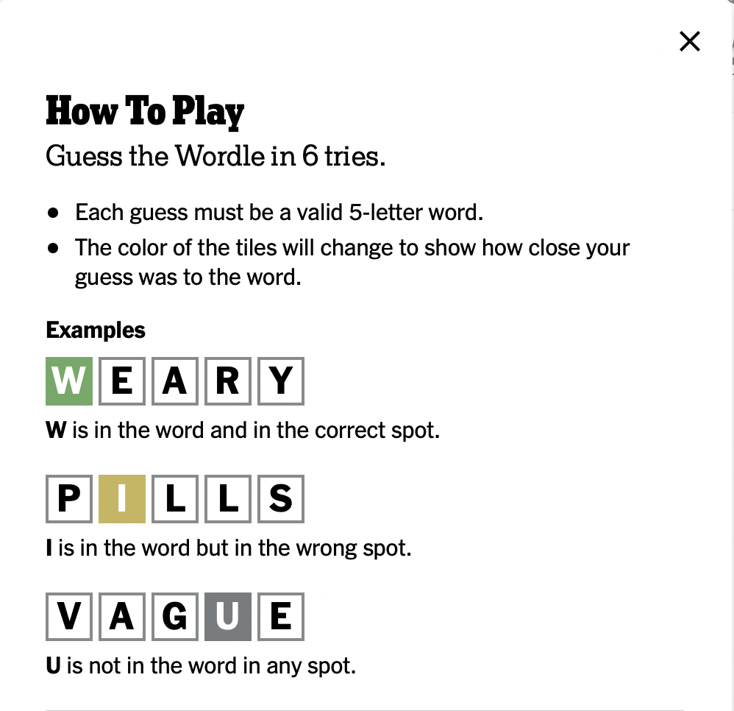
Description
Plays through wordle game
Returns colored tiles to display user progress after each guess
Extensions: Hard mode and Dark mode

Slide 3
Schedule
11/22: Game Foundation
11/29: Building Classes
12/6: Game Functionality
12/13: Testing Program

Slide 4
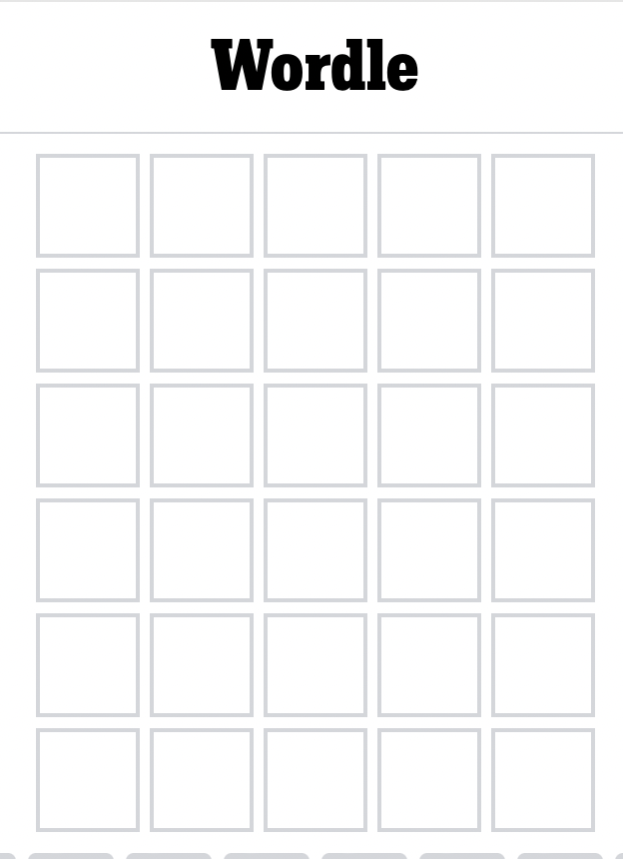
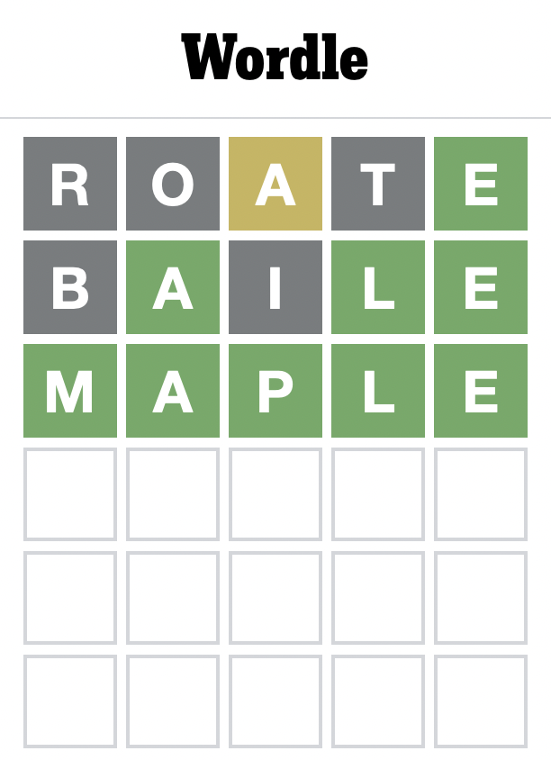
Interface

Slide 5
Classes
Game - sets up the board and adjusts to the player’s guesses
Guess - takes the player’s guess, makes sure the guess is a real word, and compares it to answer

Slide 6
Libraries
Rich
Used to print color text to see if letter positions are correct or not (Green = correct letter in the correct position, Yellow = correct letter, but in the incorrect position, Gray = incorrect letter)
Random
Used to choose which word from list as correct word in the game
Py Dictionary
Used to check if guesses are actual words in the dictionary

